Slide 1
Face recognition

Slide 2
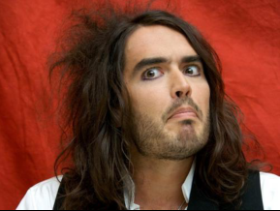
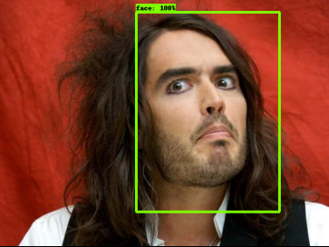
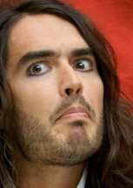


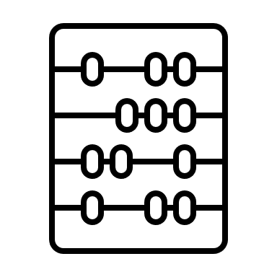

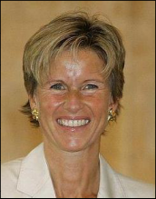
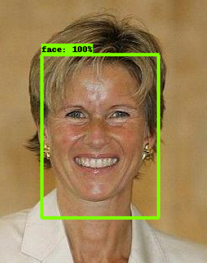
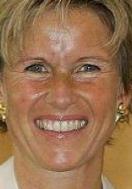

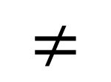
How it works
Model
Face cropping model
CNN
$$≠$$

Slide 3

Course structure
Preparing environment
Python
Keras
Siamese networks
Custom training
Computer vision

Slide 4




Python
Easy to use:
Multiparadigm, concise, high level, fast prototyping, popular for DS
Huge supported toolkit:
No need to reinvent wheel
Its not always rainbows and unicorns:
Slow, error prone in production, problems with package compatibility

Slide 5







Technologies
Numpy
Released in 2005
Linear algebra​
Jupyter notebooks
Platform for interactive computing in web browser
Keras & Tensorflow
OSS library for working with neural networks
Keras for human readable code
Anaconda
Platform for simpler environment and package management
Pandas
Tabular data
Matplotlib
Package for visualising data

